Slide 1

AI-Driven Legacy System Health Monitor
Modernizing IT Application Maintenance with Generative AI & Predictive Observability

Slide 2

The Legacy Challenge
Manual Analysis Overload
IT application maintenance teams face overwhelming difficulties monitoring legacy system health due to deeply fragmented logs and outdated monitoring tools.
This lack of real-time insight leads to inconsistent detection of system degradation, severely delayed issue resolution, and ultimately, an unacceptable increase in downtime risks.

Slide 3






Targeted Outcomes
Proactive Detection
Accelerated Resolution
Operational Reliability
Achieve highly consistent, AI-driven detection of system degradation by automatically parsing, normalizing, and filtering noise from disparate legacy data streams.
Dramatically reduce issue identification time by shifting from manual log parsing to GenAI-powered natural language summaries and actionable insights.
Enhance overall service stability, ensuring high availability and robust data privacy through zero-PII logging and synthetic testing protocols.

Slide 4

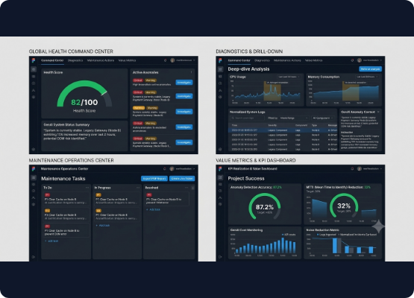
The Solution
▹
Interactive Dashboard: A centralized web UI aggregating metrics, logs, and historical incident records from across the legacy landscape.
▹
GenAI Synthesis: Utilizes advanced LLMs to transform fragmented telemetry into human-readable, natural language system summaries.
▹
Actionable Prioritization: Automatically generates and prioritizes maintenance actions (e.g., "Clear cache on Node B") to prevent outages.
▹
Exportable Reporting: Seamless creation of compliance and maintenance reports for stakeholder visibility.

Slide 5


System Architecture
1. Data ETL & Storage
2. AI & Orchestration
Legacy logs and metrics are ingested, normalized via a dedicated Python ETL pipeline (Pandas/Celery), and securely stored in a highly-available PostgreSQL database using SQLAlchemy ORM for robust data integrity and auditability.
Powered by a FastAPI asynchronous backend, the system leverages Google ADK to orchestrate LLM agents. Strict JSON schemas, Langfuse observability, and local caching ensure fast, predictable, and traceable AI inferences.

Slide 6
Value for SRE Teams
Transforming Observability
30%
By automating the correlation of disparate data sources and instantly highlighting the "Why" behind a metric spike, we empower Site Reliability Engineers (SREs) to skip the manual log-hunting phase.
This targeted 30% reduction in Mean Time To Identify (MTTI) allows engineering teams to focus purely on rapid remediation and strategic improvements.
MTTI Reduction

Slide 7
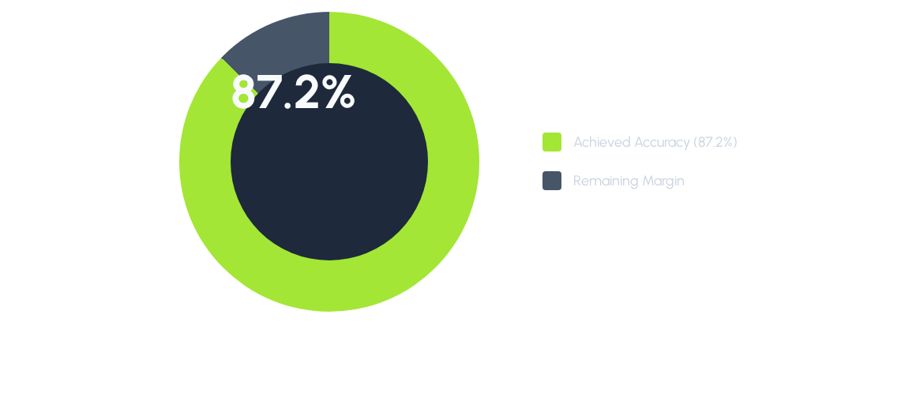
KPI Realization
Against our problem statement baseline, the GenAI anomaly detection model has successfully surpassed the target KPI of 85%, currently operating at a validated 87.2% accuracy with minimal false positives.

Slide 8
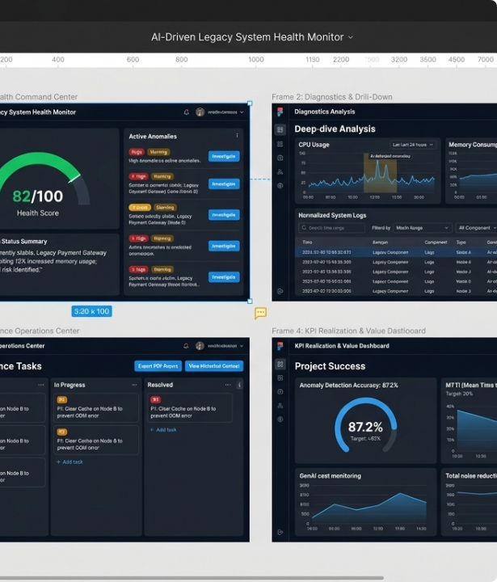
Live Demonstration
From Synthetic to Real-Time
We will now transition into the interactive application to walk through a live, simulated degradation event.
Watch as the GenAI Engine automatically detects a memory leak, parses the relevant fragmented logs, and issues a P1 task to the Maintenance Operations Center.

Slide 9
Questions?
Thank you for your time.

Slide 10

Image Sources
https://flashdba.com/wp-content/uploads/2026/04/data-centre.jpg
Source: flashdba.com

